Slide 1
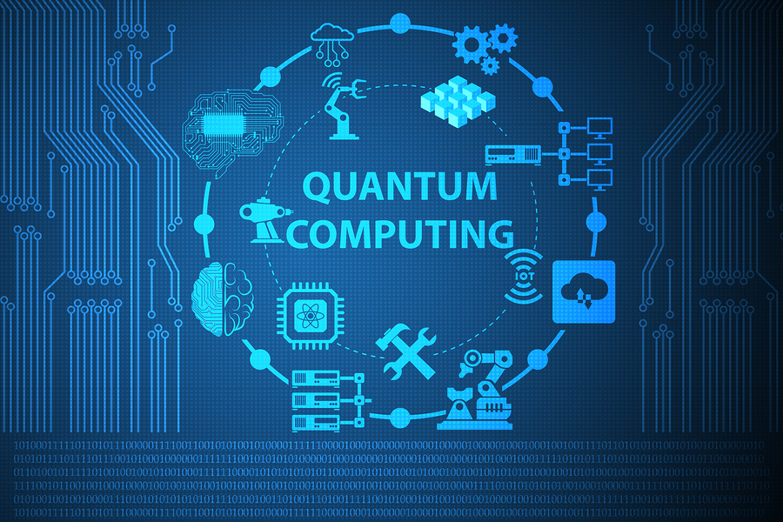
Quantum Computer
Hugo Blaschyk
Michael Hofmann

Slide 2
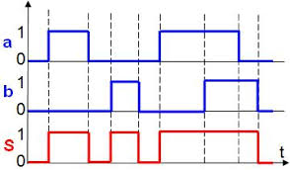
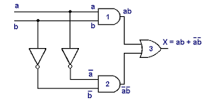
Classical bit:
Logic gates:

Slide 3
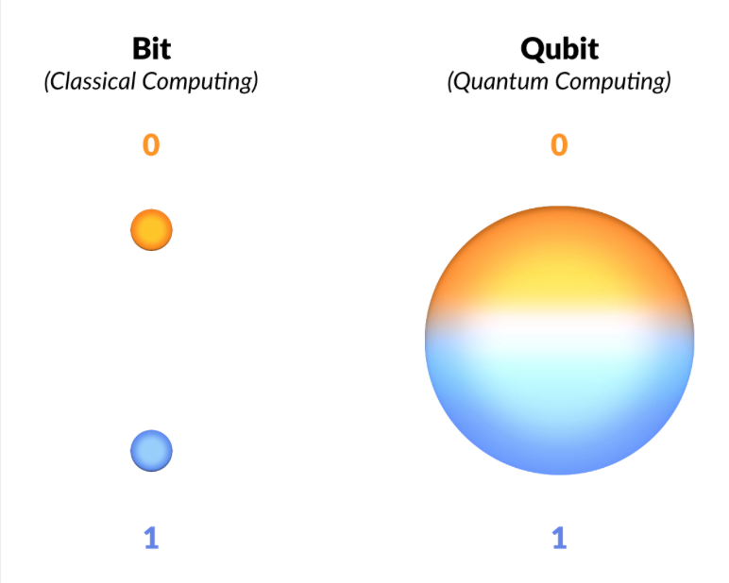
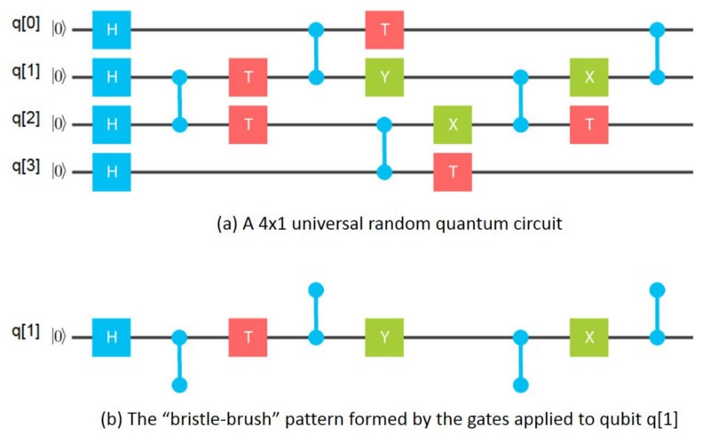
Q-Bit:
| 1> + |0>
Quantum Gates:

Slide 4
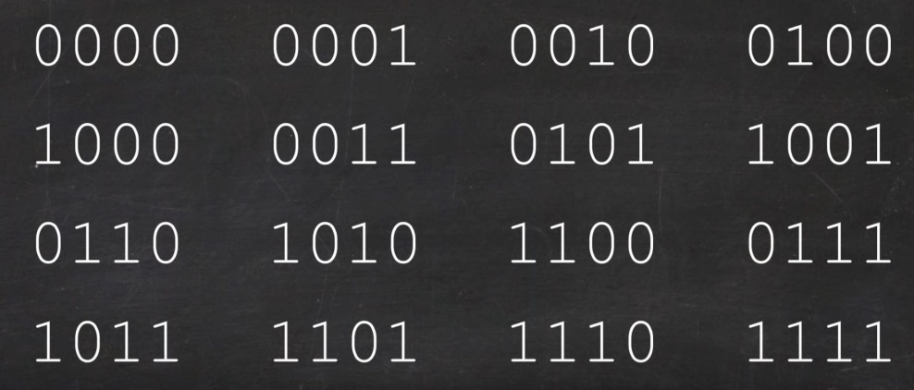
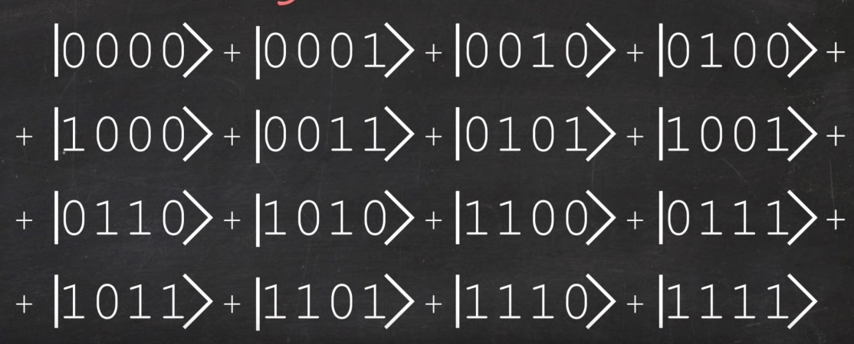
Idea of quantum supremacy:

Slide 5
Specifics algorythms
X | F(X)
1 | 44
2 | 1
3 | 9
4 | 7
5 | 46
6 | 54
7 | 31
8 | 4
9 | 16
Classic : N steps
Quantum : √N steps

Slide 6
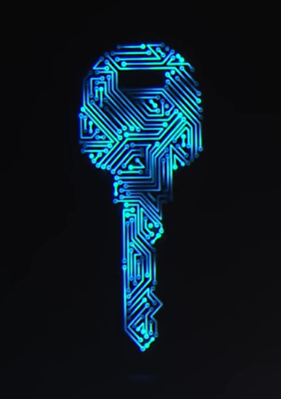
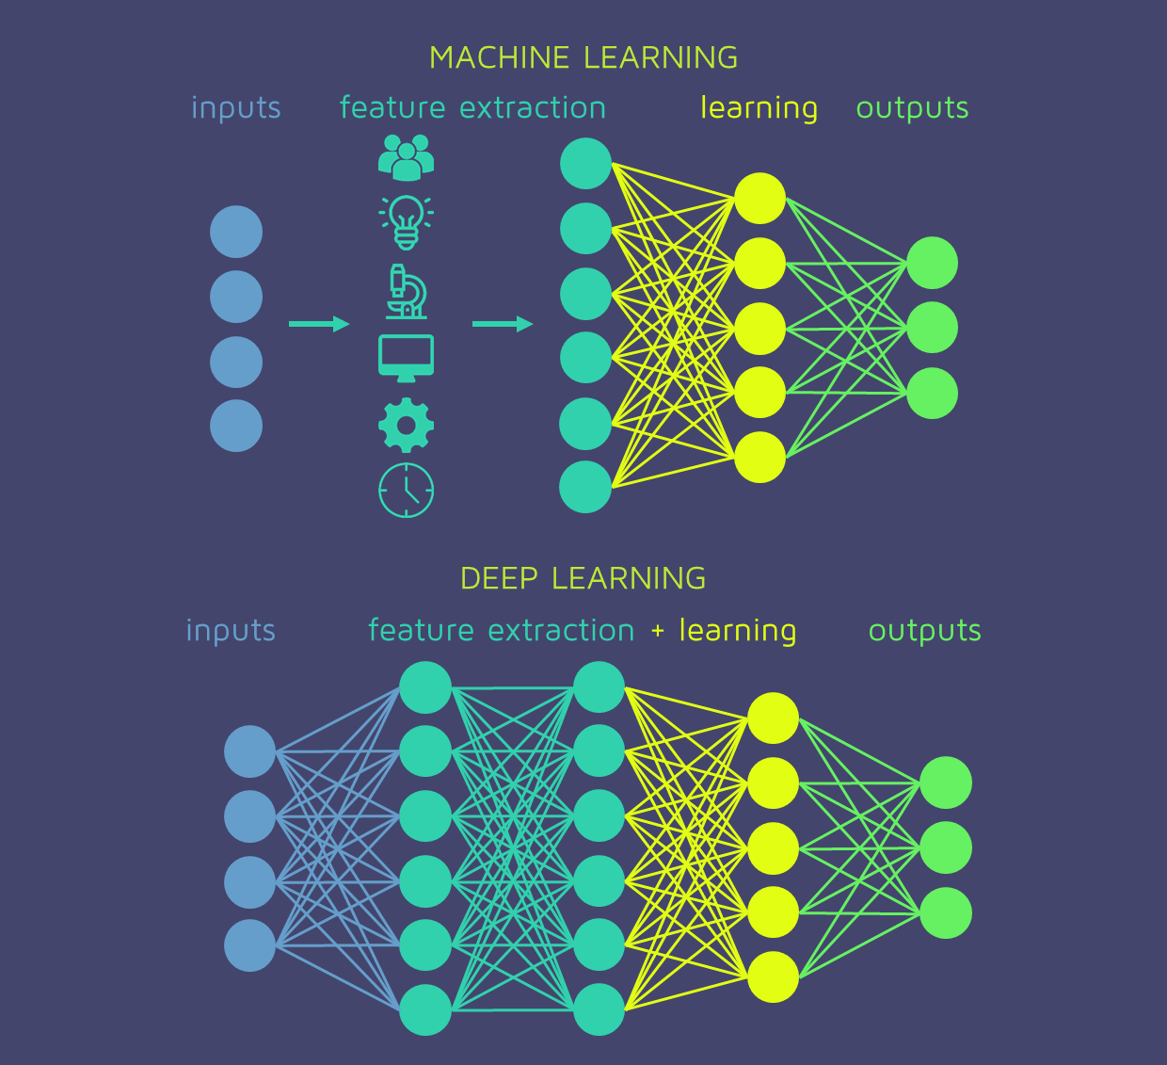
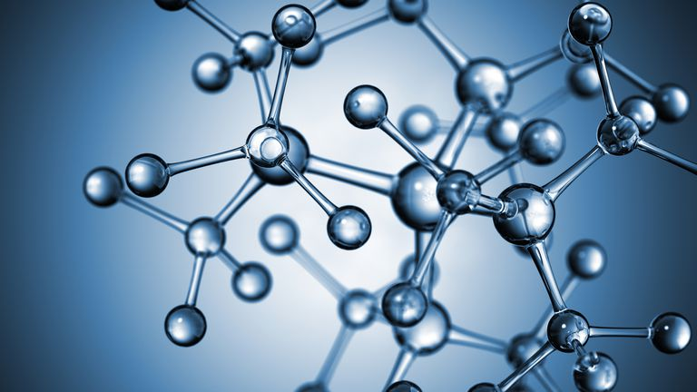
Applications

Slide 7
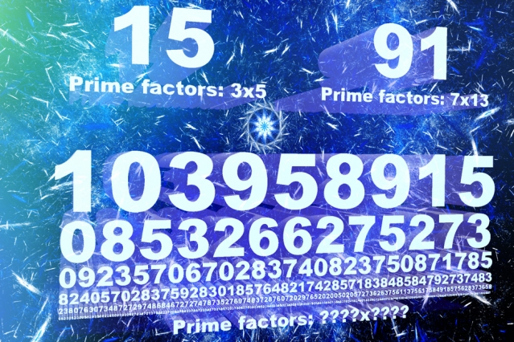
Factoring large numbers

Slide 8

Cybersecurity

Slide 9
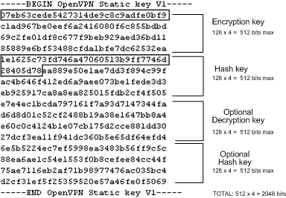
Encryption key and Digital signature

Slide 10

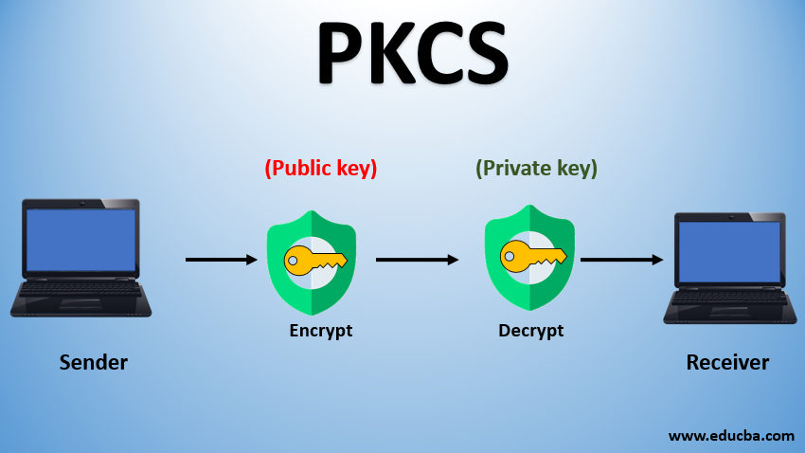
Cryptography Standards of the web

Slide 11
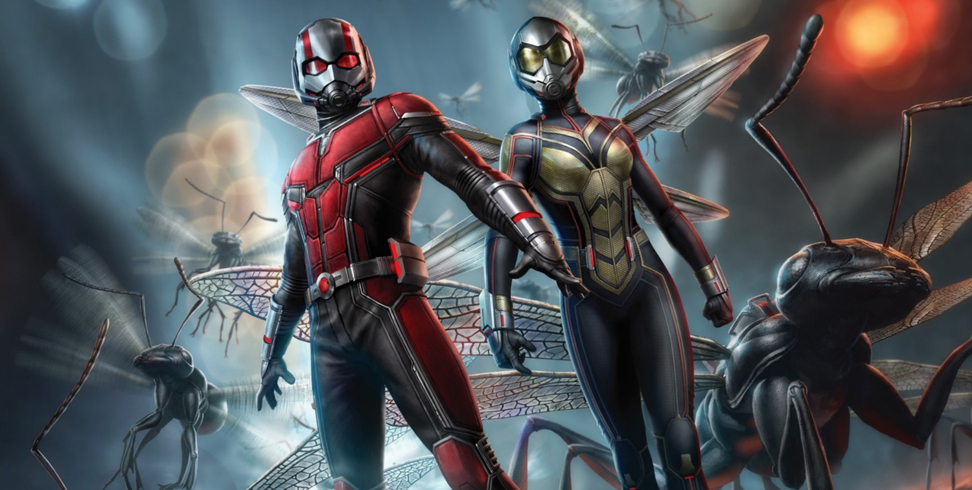
Conclusion

Slide 12
A beginner's guide to quantum computing – TED talk:
https://www.youtube.com/watch?v=QuR969uMICM
The quantum computers explained – Kurzgesagt:
https://www.youtube.com/watch?v=JhHMJCUmq28

